Slide 1
MIS 321
Responsive Design / Twitter Bootstrap
Fall - 2020

Slide 2
Responsive Design
The goal of responsive design is to create sites that adjust their view or “respond” based on the viewing size of the device.
Bootstrap is the most popular framework for developing responsive sites.

Slide 3
Bootstrap
Bootstrap is an open source, available for public use.
The full Bootstrap framework includes HTML, CSS, and JavaScript.
Includes design templates for typography, forms, buttons, tables, navigation, modals, etc.
Often referred to as “Twitter Bootstrap”
Created by Mark Otto and Jacob Thornton at Twitter, and released as an open source project in 2011

Slide 4
How to Use Bootstrap
Download and run locally
Can be downloaded from getbootstrap.com
Include Bootstrap from a Content Delivery Network (CDN)
MaxCDN provides support for Bootstrap’s CSS and JavaScript.
Must also include jQuery in project
Using CDN may allow site to load faster for users that have records in cache from other sites that use the same CDN

Slide 5
Using Bootstrap CND
Must include Bootstrap’s CSS, JavaScript, and jQuery from MaxCDN
<!-- Latest compiled and minified Bootstrap CSS --> <link rel="stylesheet"href="https://maxcdn.bootstrapcdn.com/bootstrap/3.3.7/css/bootstrap.min.css">
<!-- Latest compiled Bootstrap JavaScript --> <script src="https://maxcdn.bootstrapcdn.com/bootstrap/3.3.7/js/bootstrap.min.js"></script>
<!-- latest jQuery library --> <script src="https://code.jquery.com/jquery-latest.js"></script>

Slide 6
Mobile - First
Bootstrap is mobile-first
Designed to be responsive to mobile devices.
Mobile-first styles are part of the core framework.
To ensure proper rendering and touch zooming, you must have the following tag in the <head> element
<meta name="viewport" content="width=device-width, initial-scale=1">
This sets the width = the width of the screen on the device being used
Also sets the initial zoom scale to 1 when the page is loaded

Slide 7
Add a Container
Bootstrap requires a containing element to wrap site content.
There are two container classes to choose from:
.container provides a responsive fixed width container with some padding
.container-fluid provides a full width container, spanning the entire width of the viewport

Slide 8
Bootstrap Grids
The Bootstrap grid is what enables the responsive design
Bootstrap breaks the page into 12 columns and any number of rows
You can put content in a single column or group them together.
The columns will re-arrange automatically depending on screen size

Slide 9
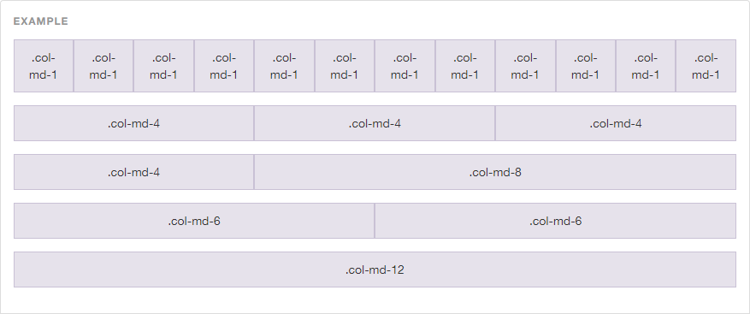
Example Grid Layout

Slide 10
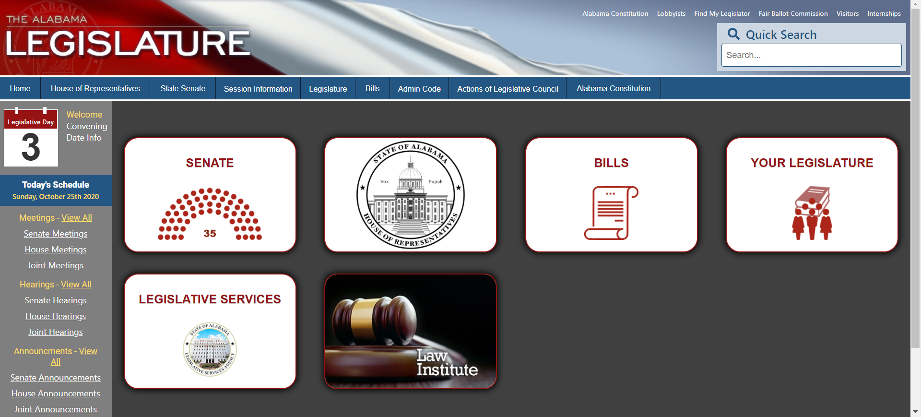
Example Grid

Slide 11
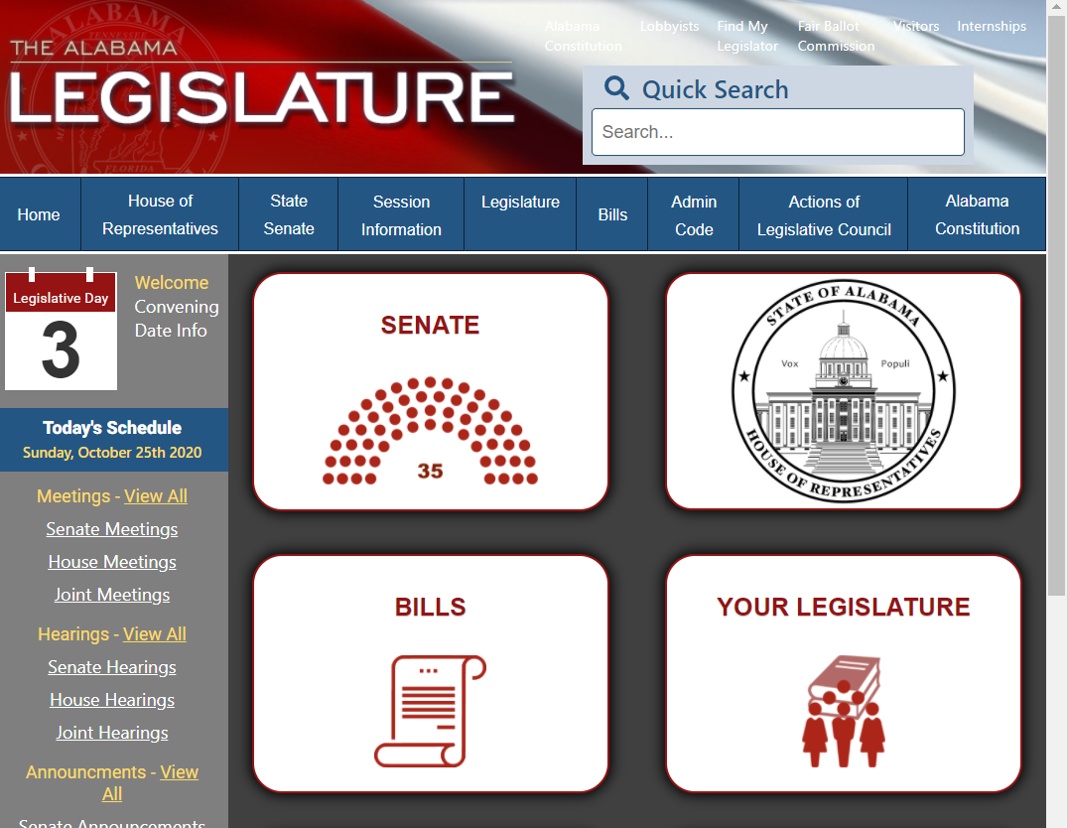
Example Grid

Slide 12
Grid Classes
<div class="col-md-12">Span 12 columns</div>
<div class="col-md-6">Span 6</div><div class="col-md-6">Span 6</div>
<div class="col-md-4">Span 4</div><div class="col-md-8">Span 8</div>
<div class="col-md-4">Span 4</div><div class="col-md-4">Span 4</div> <div class="col-md-4">Span 4</div>
The Bootstrap grid system has four classes:
xs (for phones)
sm (for tablets)
md (for desktops)
lg (for larger desktops)
The classes above can be combined to create more dynamic and flexible layouts.

Slide 13
Basic Structure
Create a <div> with class = “row”
Add nested <div> statements with class=“col-?-?”.
For example col-md-6
Columns should add up to 12
Example code for 3 equal columns.
<div class="container">
<h1>Three Equal Columns</h1>
<p>Desktops version: .col-md-4</p>
<div class="row">
<div class="col-md-4">.col-md-4</div>
<div class="col-md-4">.col-md-4</div>
<div class="col-md-4">.col-md-4</div>
</div>
</div>

Slide 14
Sample Design Templates
Tables
Basic table has light padding and only horizontal dividers. class=“table”
Striped table adds zebra-stripes to a table. class=“table-striped”
Bordered table adds borders on all sides of the table and cells. class=“table-bordered”
Hover tables enables a hover state on table rows. class=“table-hover”

Slide 15
Sample Design Templates
Images
Rounded corners will add rounded corners to an image. class=“img-rounded”
class=“img-circle” will shape the image to a circle.
class=“img-thumbnail” will turn the image into a thumbnail
Responsive Images
Images come in all sizes as do screens.
class=“img-responsive” will automatically adjust to the fit of the screen and the parent element

Slide 16
Sample Design Templates
There are 7 Button styles:
.btn-default
.btn-primary
.btn-success
.btn-info
.btn-warning
.btn-danger
.btn-link
* Can be used with <a> <button> <input> elements
4 Button Sizes:
.btn-lg
.btn-md
.btn-sm
.btn-xs

Slide 17
Other Helpful Button Features
.btn-block will create a block level button that spans the entire width of the parent element.
A button can be set to active or disabled state.
.active and .disabled

